Slide 1
DYNAMIC PROGRAMMING

Slide 2
THE GENERAL METHOD
Dynamic Programming is an algorithm design method that can be used when the solution to a problem may be viewed as the result of a sequence of decisions.
An optimal sequence of decisions may be found by making the decisions one at a time and never making an erroneous decision. This is true for all problems solvable by the greedy method.

Slide 3
THE GENERAL METHOD
Try out all possible decision sequences. We could enumerate all decision sequences and then pick out the best.
In dynamic programming an optimal sequence of decisions is arrived at by making explicit appeal to the Principle of Optimality.

Slide 4
THE GENERAL METHOD
Principle of Optimality states that an optimal sequence of decisions has the property that whatever the initial state and decision are, the remaining decisions must constitute an optimal decision sequence with regard to the state resulting from the first decision.
Thus, the essential difference between the greedy method and dynamic programming is that in the greedy method only one decision sequence is ever generated. In dynamic programming, many decision sequences may be generated.

Slide 5
Rod cutting
Our first example uses dynamic programming to solve a simple problem in deciding where to cut steel rods. Serling Enterprises buys long steel rods and cuts them into shorter rods, which it then sells. Each cut is free. The management of Serling Enterprises wants to know the best way to cut up the rods.
We assume that we know, for i = 1, 2, …., the price p_{i} in dollars that Serling Enterprises charges for a rod of length i inches. Rod lengths are always an integral number of inches.

Slide 6
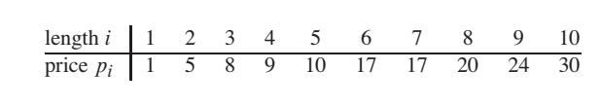
Rod cutting

Slide 7
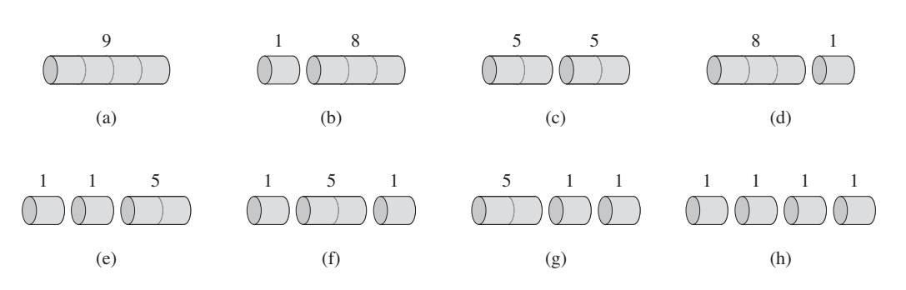

Slide 8
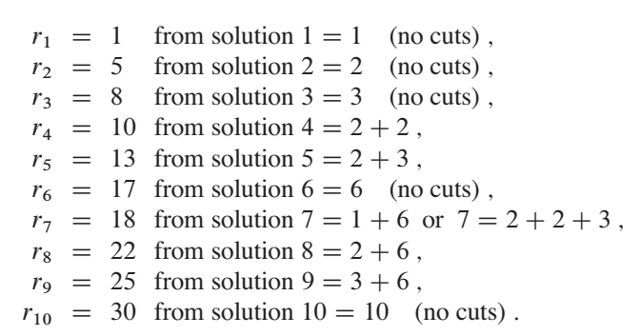
Rod cutting

Slide 9
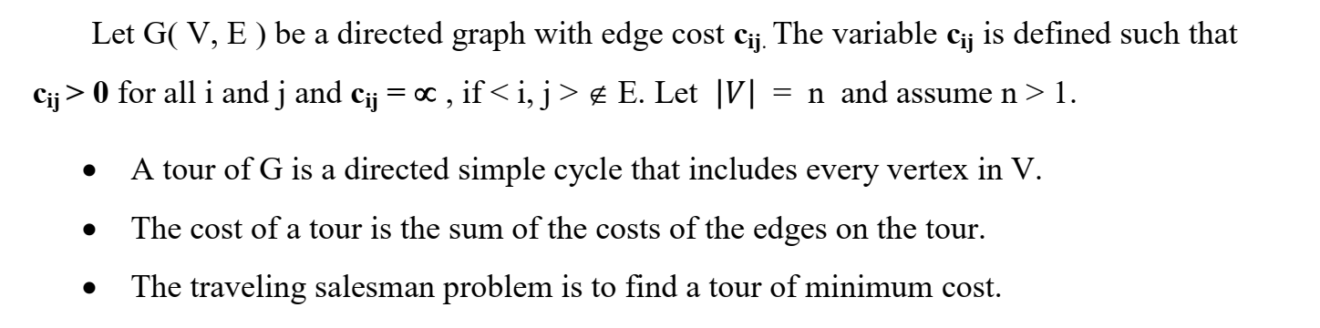
Travelling Salesperson Problem

Slide 10
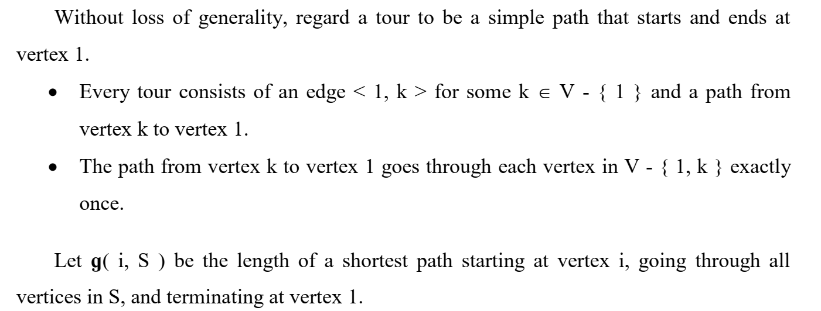
Travelling Salesperson Problem

Slide 11
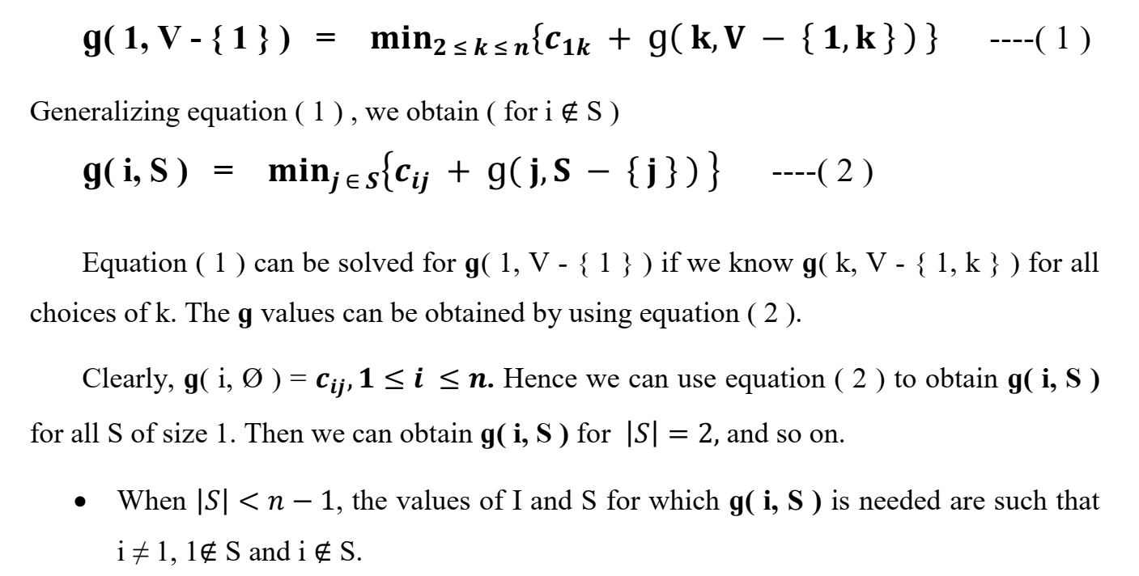
Travelling Salesperson Problem

Slide 12
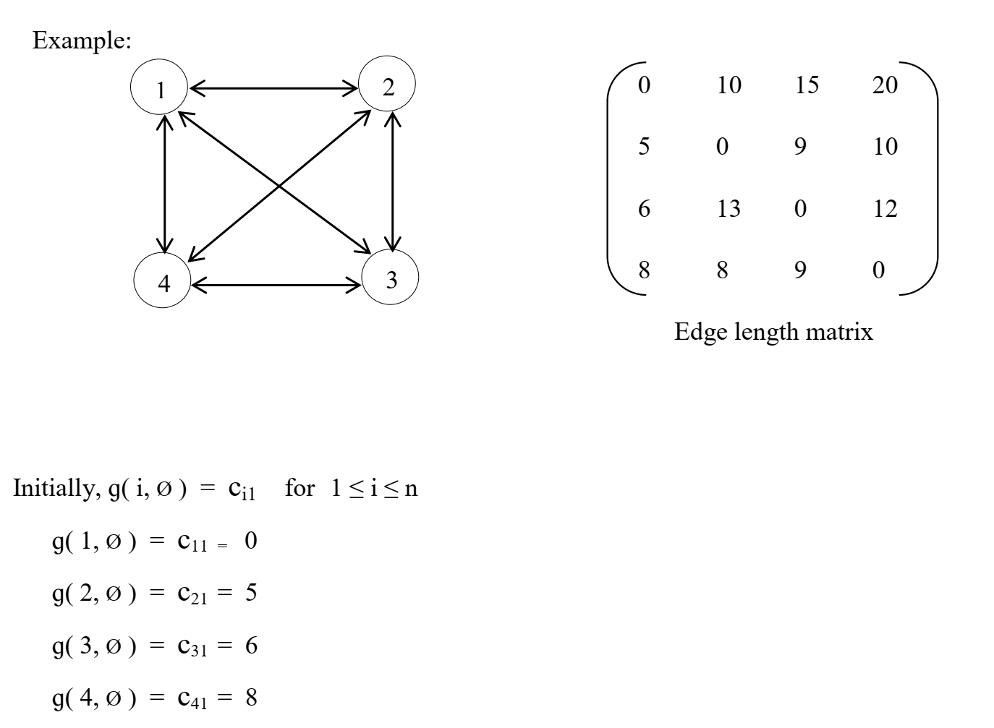
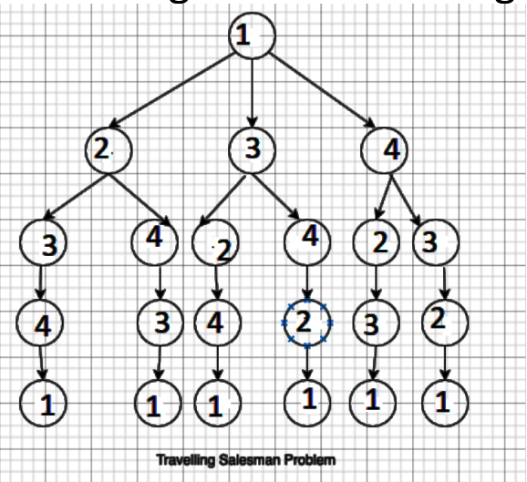
Travelling Salesperson Problem

Slide 13
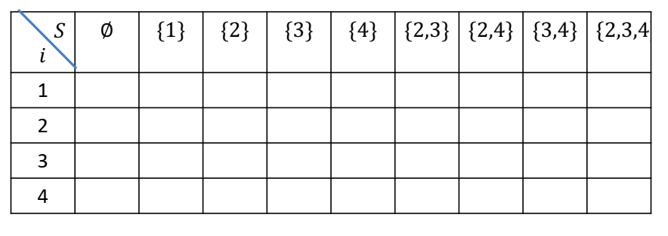
Travelling Salesperson Problem

Slide 14
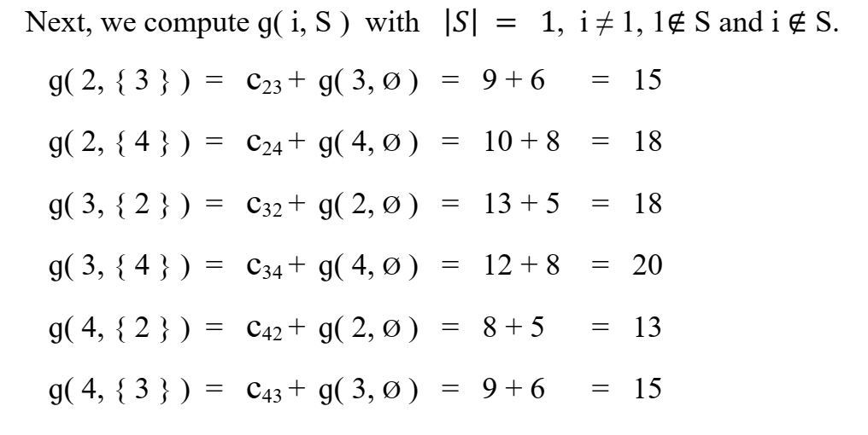
Travelling Salesperson Problem

Slide 15
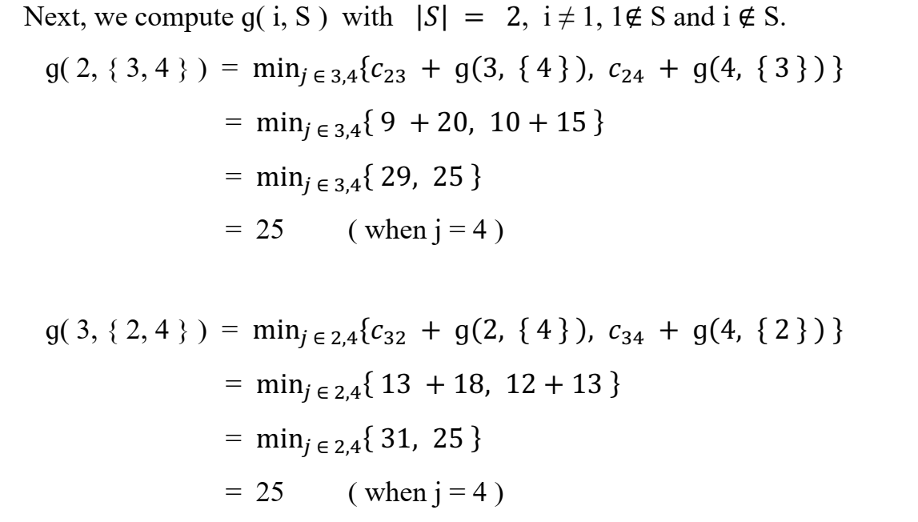
Travelling Salesperson Problem

Slide 16
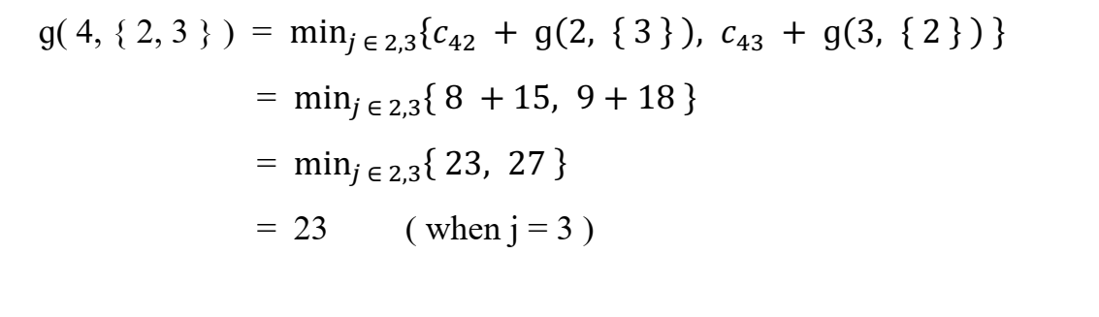
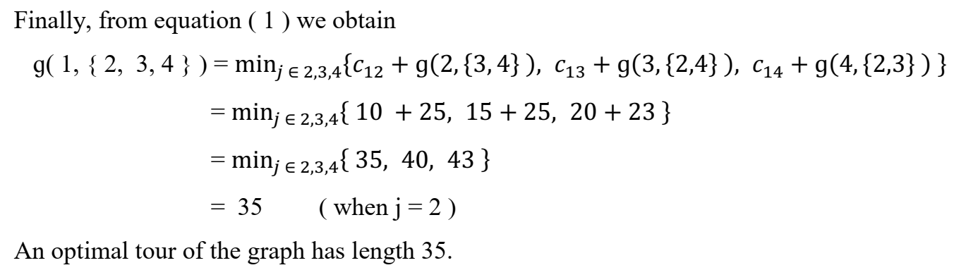
Travelling Salesperson Problem

Slide 17
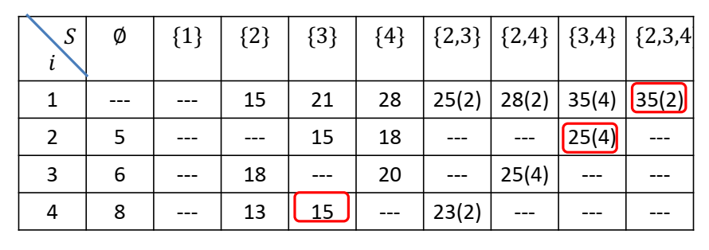
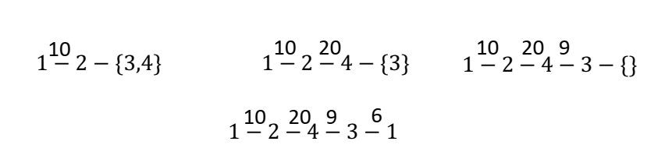
Travelling Salesperson Problem

Slide 18
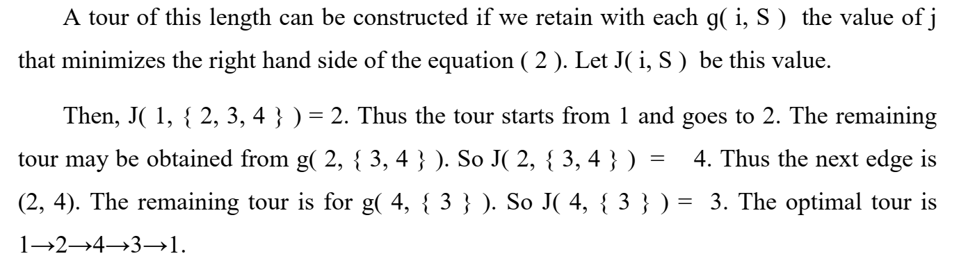
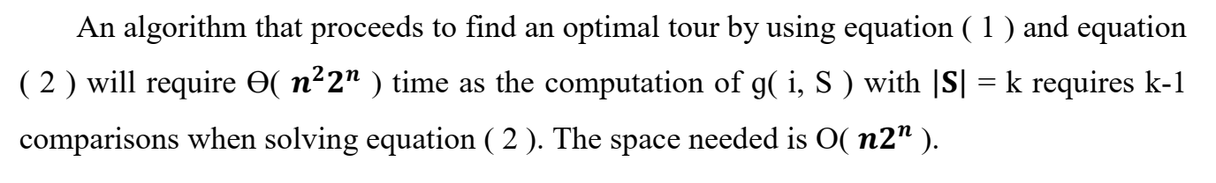
Travelling Salesperson Problem

Slide 19
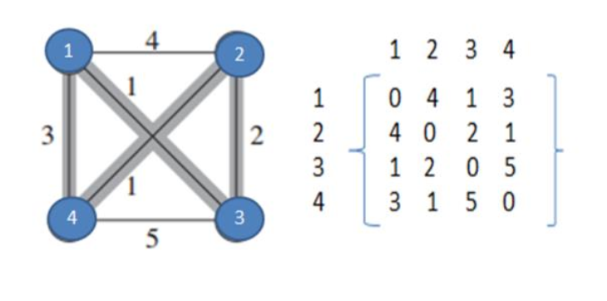
Travelling Salesperson Problem

Slide 20
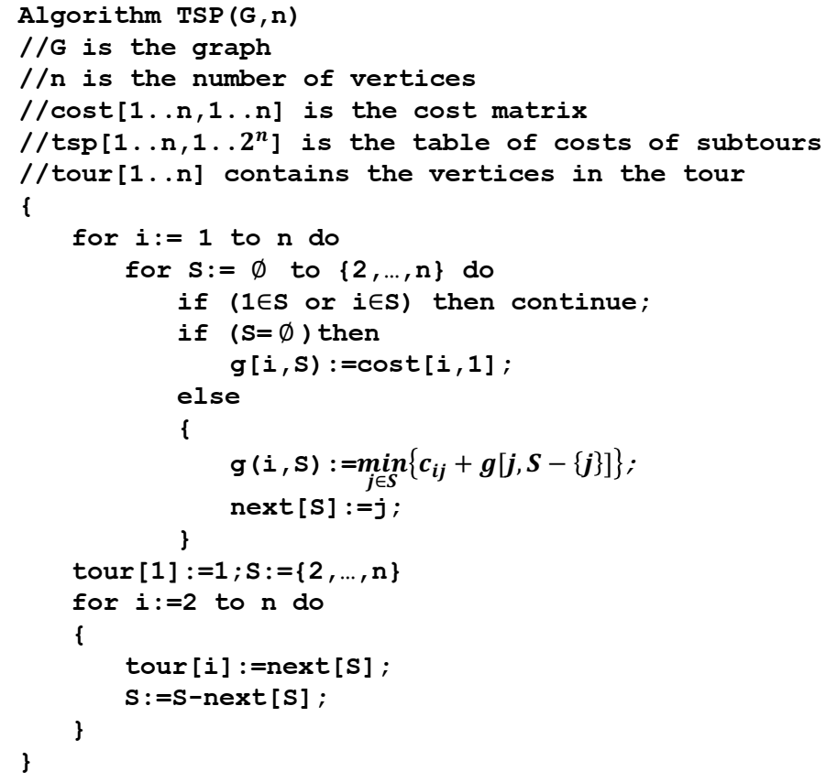
Travelling Salesperson Problem

Slide 21
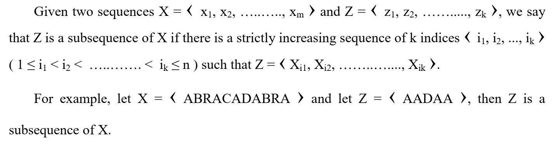
Longest Common Subsequence

Slide 22
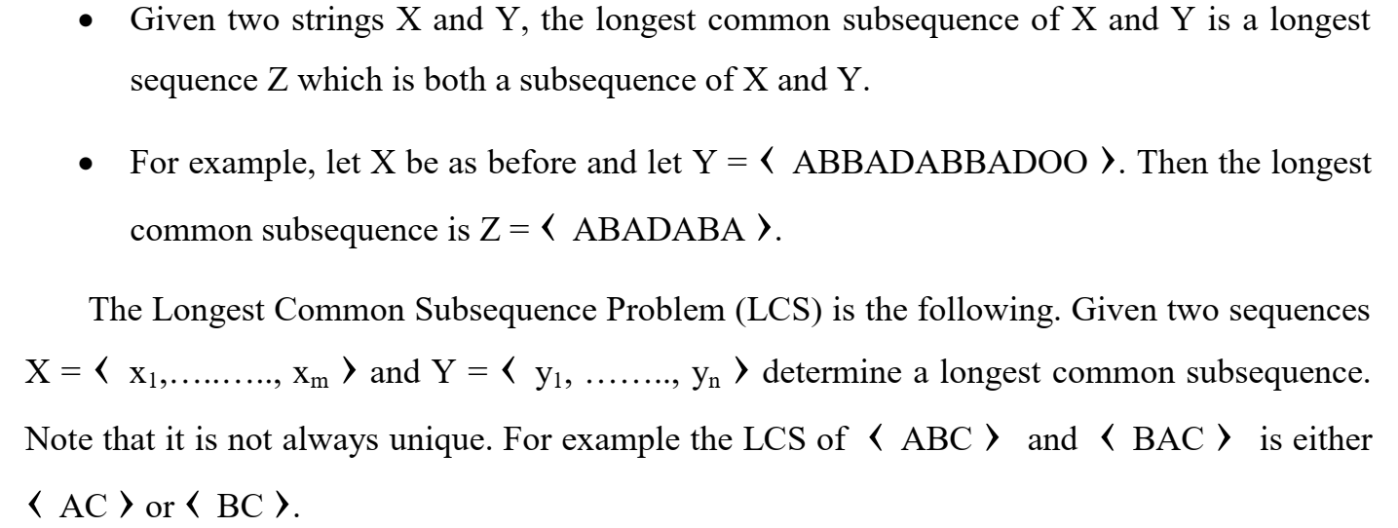
Longest Common Subsequence

Slide 23
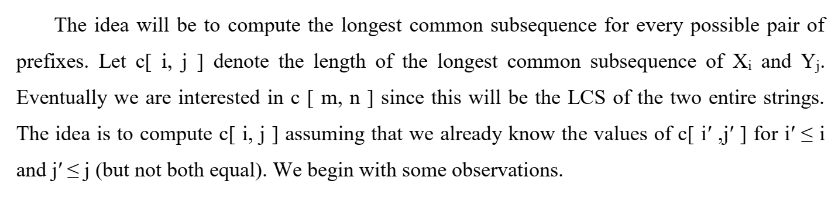
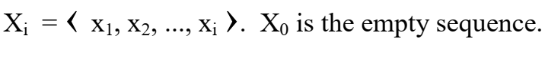
Longest Common Subsequence

Slide 24
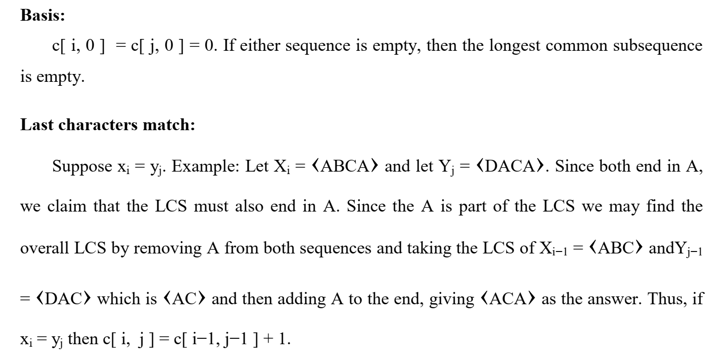
Longest Common Subsequence

Slide 25
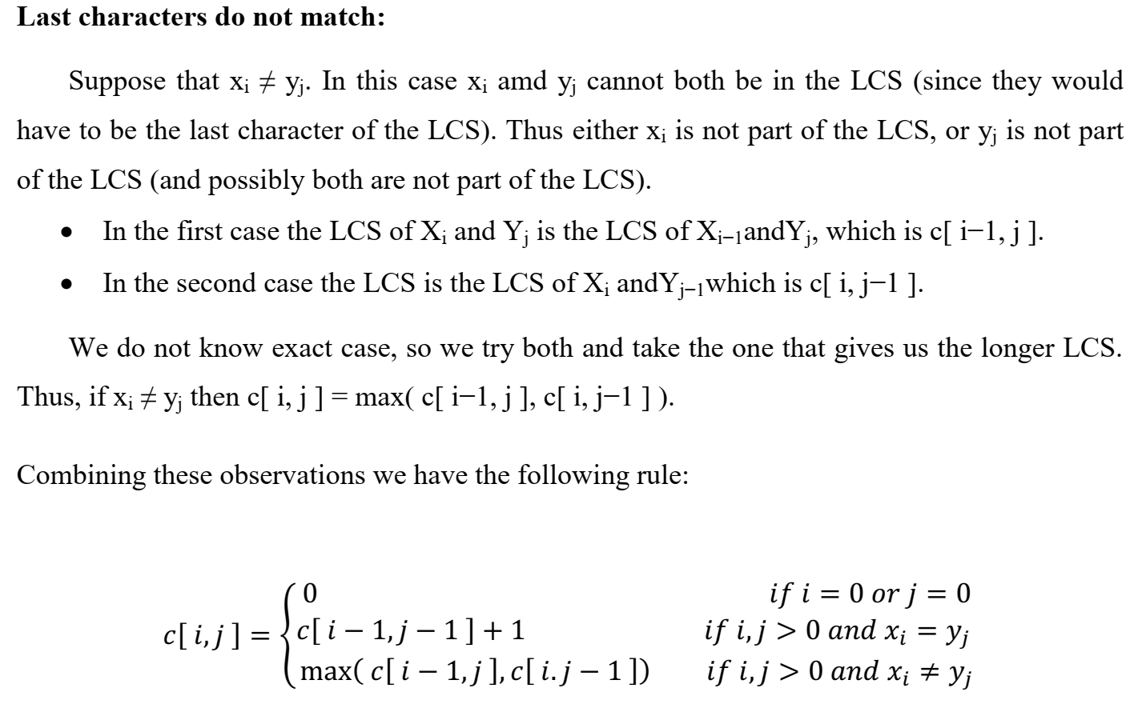
Longest Common Subsequence

Slide 26
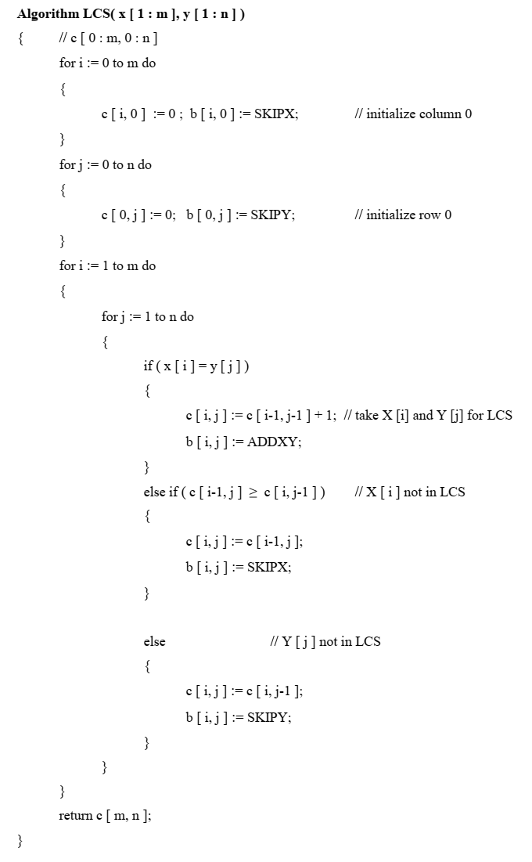
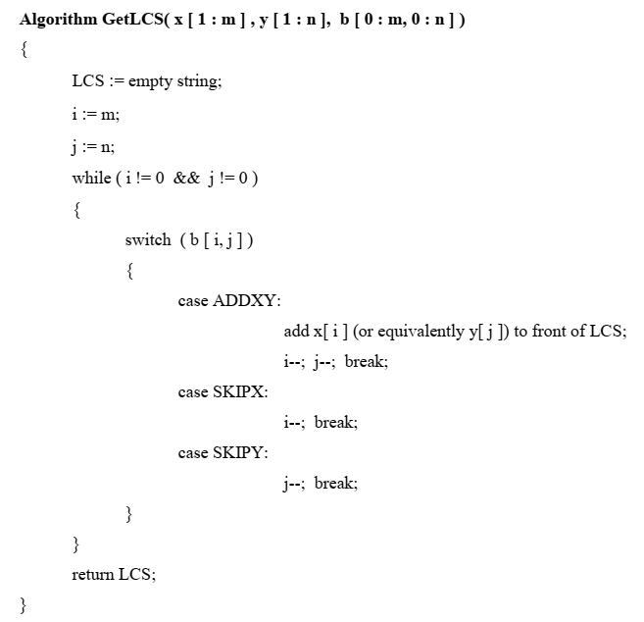

Slide 27
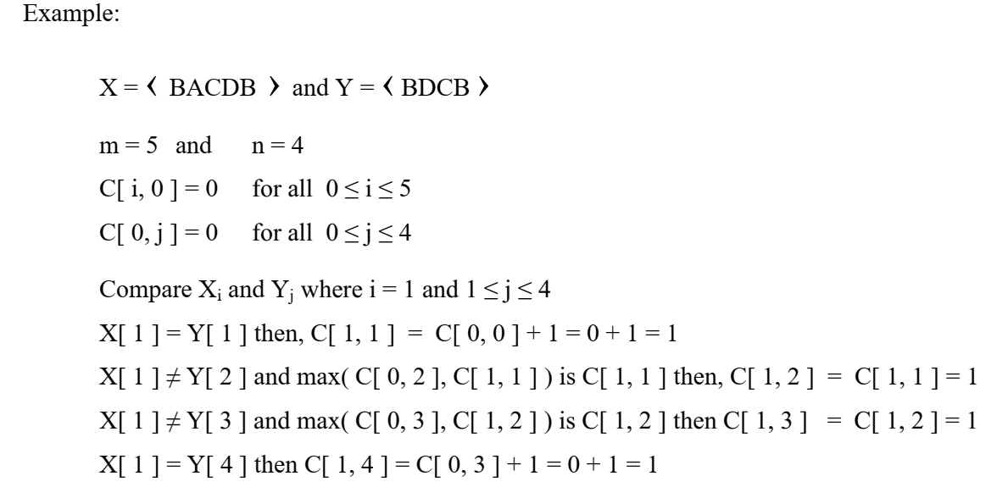
Longest Common Subsequence

Slide 28
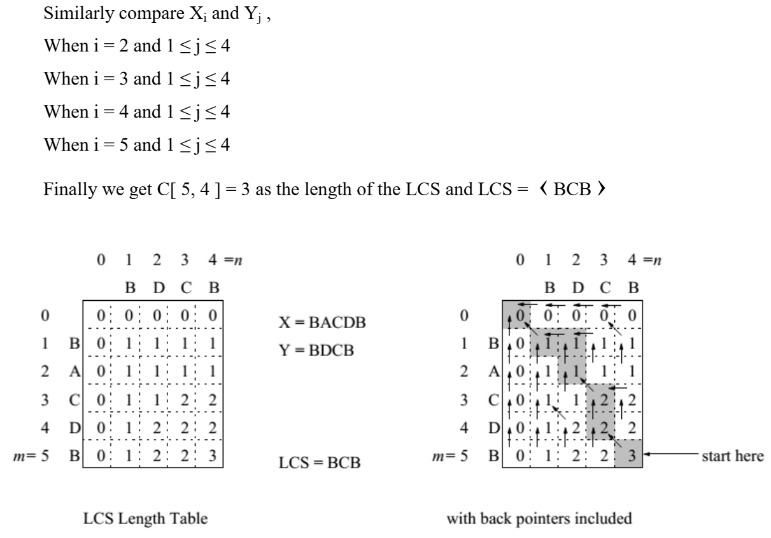
Longest Common Subsequence

Slide 29
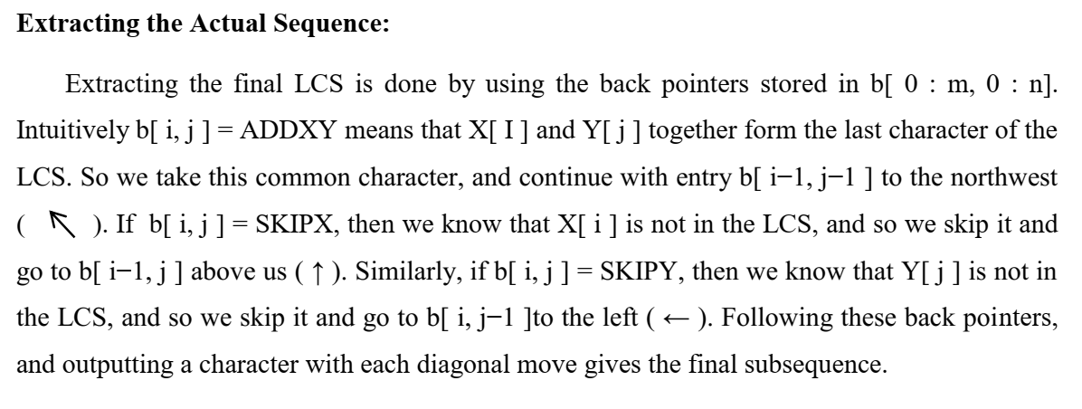
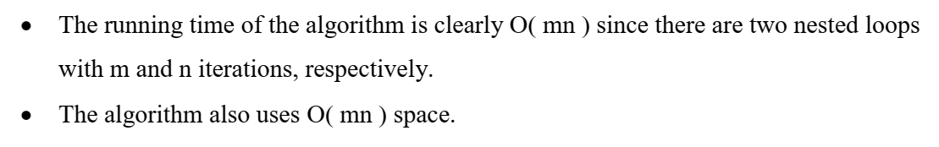
Longest Common Subsequence

Slide 30
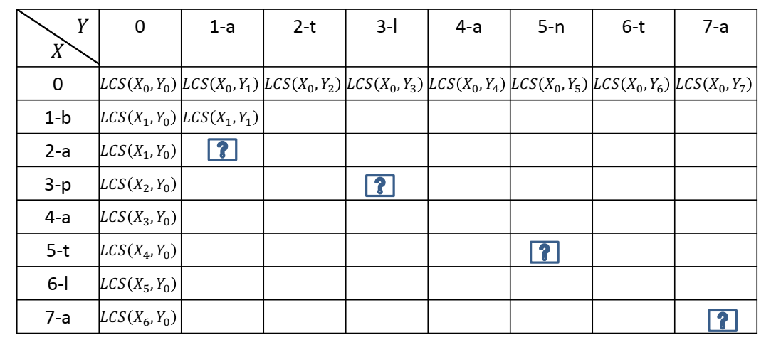
Longest Common Subsequence

Slide 31
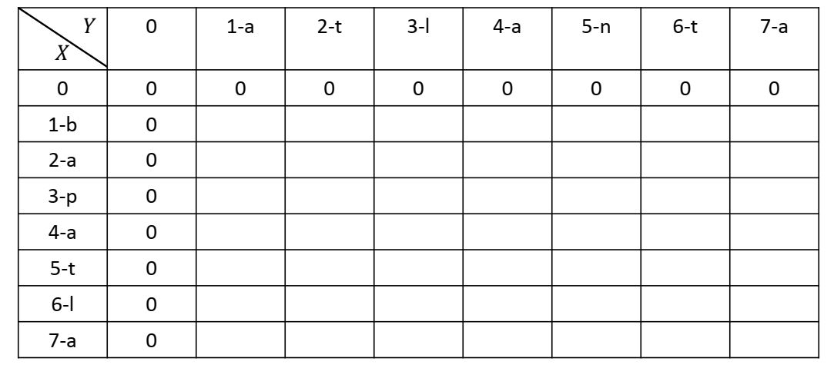
Longest Common Subsequence

Slide 32
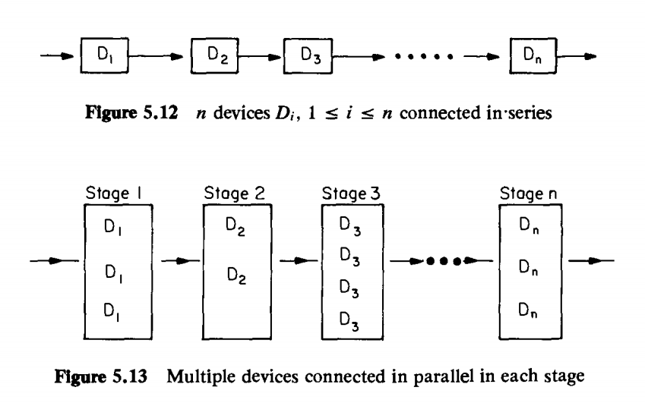
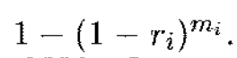
Reliability Design

Slide 33
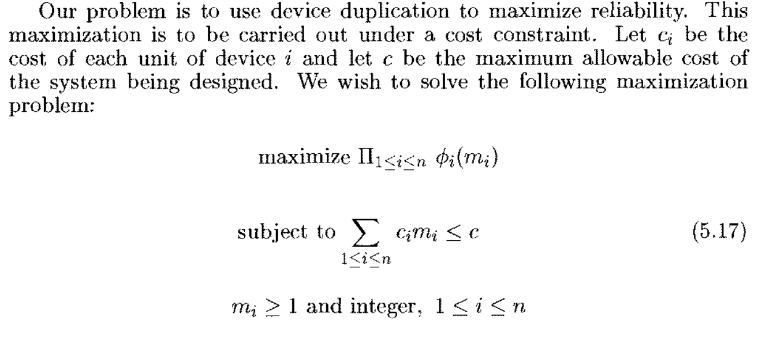
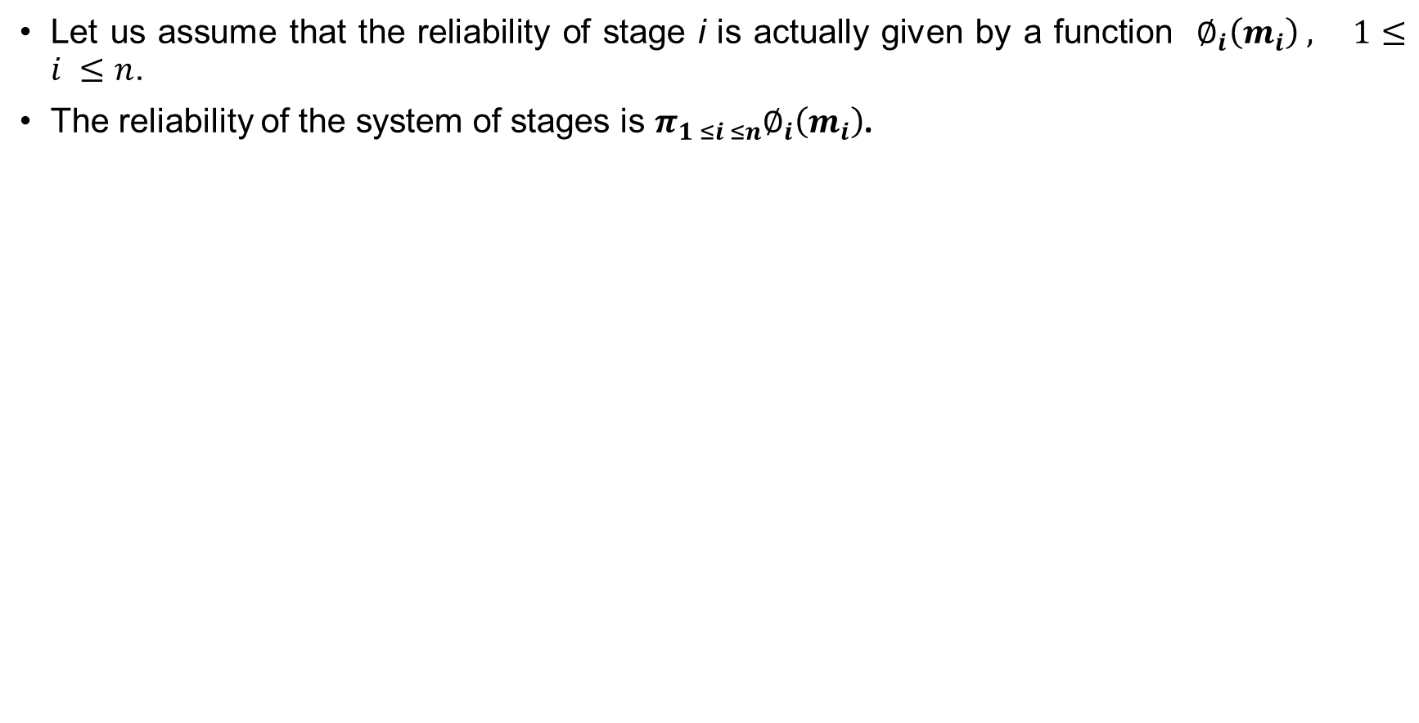
Reliability Design
Let us assume that the reliability of stage i is actually given by a function $∅_{i}\left(m_{i}\right) , 1≤i ≤n$.
The reliability of the system of stages is $π_{1 ≤i ≤n}∅_{i}\left(m_{i}\right)$.

Slide 34
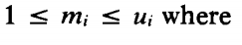
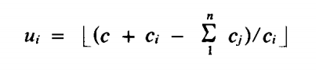
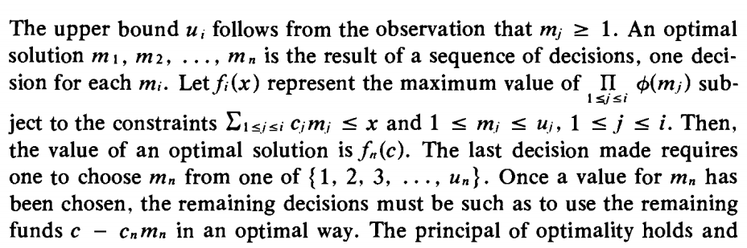
Reliability Design
we may assume each c_{i} > 0, each m_{i} must be in the range

Slide 35
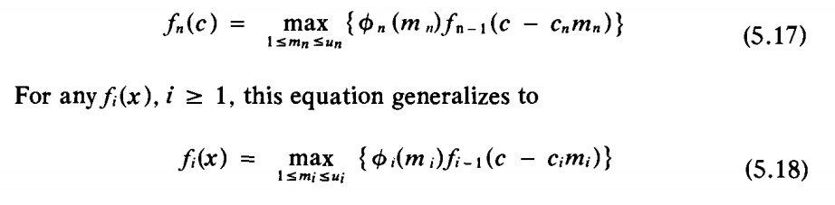
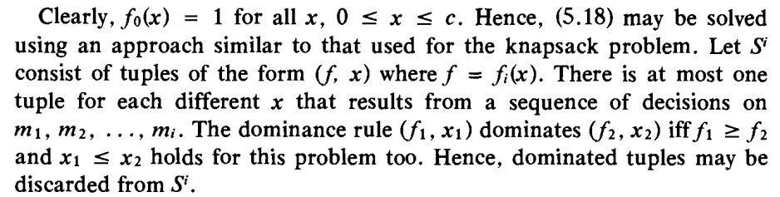
Reliability Design

Slide 36
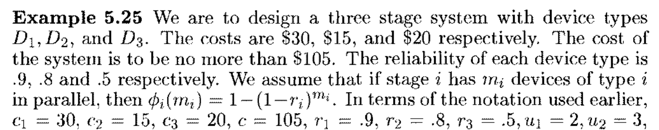

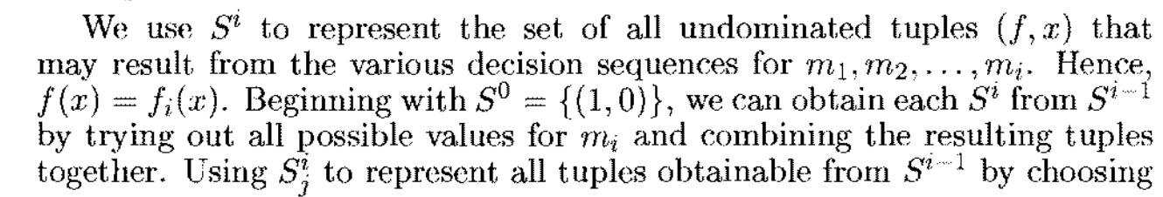
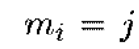
Reliability Design

Slide 37
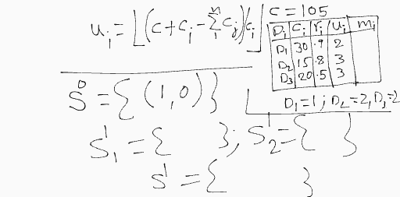
Reliability Design

Slide 38
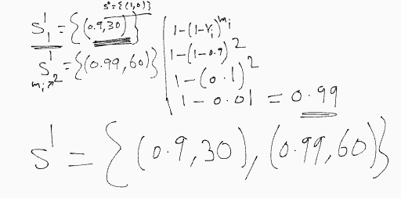
Reliability Design

Slide 39
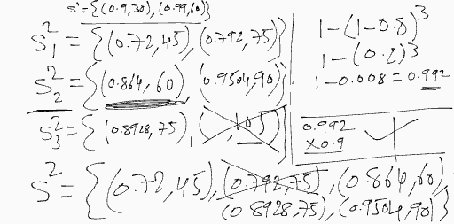
Reliability Design

Slide 40
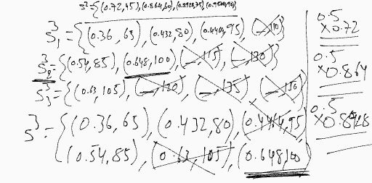
Reliability Design

Slide 41
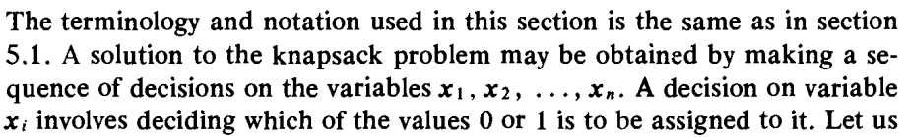

0/1-KNAPSACK

Slide 42

0/1-KNAPSACK

Slide 43


0/1-KNAPSACK

Slide 44

0/1-KNAPSACK

Slide 45

0/1-KNAPSACK

Slide 46


Slide 47


Slide 48

Travelling Salesperson Problem

Slide 49
Longest Common Subsequence

Slide 50

Multistage Graph

Slide 51

0/1-KNAPSACK

